Slide 1

Sarcasm Detection
Adam ElHefnawy – 193183
Supervised By:
Associate Prof. Nahla Barakat

Slide 2

1.Introduction

Slide 3
Introduction
Sarcasm detection is a formidable challenge in natural language processing.
It requires a comprehensive understanding of contextual nuances and intended meaning.
Researchers have dedicated substantial efforts to developing methods and models for sarcasm detection.
The task remains complex due to the interplay between linguistic cues and underlying sarcasm.
This graduation project aims to advance the state of the art in sarcasm detection.
The specific focus is on detecting sarcasm in news headlines.

Slide 4
Motivation
Enhancing News Accuracy: Sarcasm in news headlines can often mislead readers, leading to misunderstandings or incorrect interpretations of the information. By developing sarcasm detection models, we can improve the overall accuracy of news reporting and ensure that readers receive reliable and truthful information.
Preventing Misinformation Spread: Sarcasm can be easily misunderstood, especially when taken out of context. Detecting sarcasm in news headlines can help prevent the spread of misinformation and the subsequent negative impact it may have on public opinion and decision-making.

Slide 5
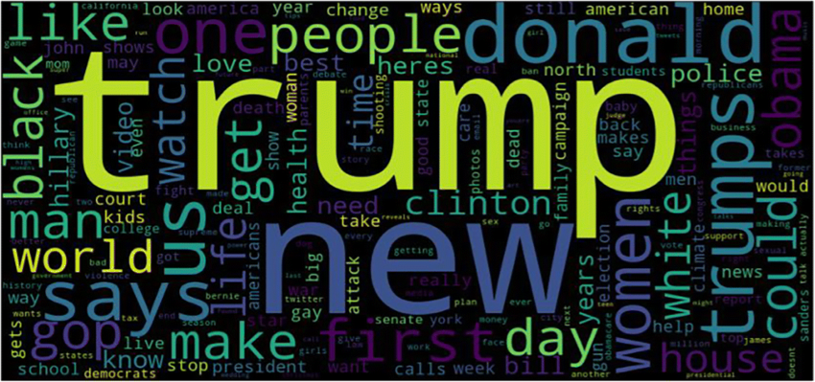
2 Dataset

Slide 6
Dataset : Dataset: News Headlines for Sarcasm Detection
File Format: JSON
Collected from two news websites:
TheOnion: Produces sarcastic versions of current events.
Headlines collected from "News in Brief" and "News in Photos" categories (sarcastic).
HuffPost: Provides real and non-sarcastic news.
Headlines collected from HuffPost (non-sarcastic).

Slide 7
Dataset Content
earticle_link | headline | is_sarcastic
https://www.huffingtonpost.com/entry/facebook-healthcare_n_5926140.html | facebook reportedly working on healthcare features and apps | 0
https://www.theonion.com/nasa-now-almost-positive-mars-is-rocky-1819573727 | Nasa now almost positive mars is rocky | 1
https://www.theonion.com/sun-thinking-of-just-collapsing-now-and-getting-this-al-1821437839 | sun thinking of just collapsing now and getting this all over with | 1
https://www.huffingtonpost.com/entry/baltimore-bus-crash_us_58189085e4b064e1b4b4a389 | six dead, 10 hurt in baltimore commuter, school bus crash | 0
Each record consists of three attributes:
is_sarcastic: 1 if the record is sarcastic, otherwise 0.
headline: the headline of the news article.
article_link: link to the original news article.

Slide 8

Models

Slide 9

Models Build
SVM
LSTM
BLSTM
BERT + BLSTM

Slide 10
First model : SVM

Slide 11
First model - SVM
simple model was employed to establish a baseline for performance.
Created a function, preprocess_text, to process the text data.
Removed punctuation, converting the text to lowercase.
Eliminated numbers and extra whitespace.
Applying TF-IDF vectorization to convert textual data into a numerical representation.
Employing an SVM (Support Vector Machine) classifier with a linear kernel

Slide 12
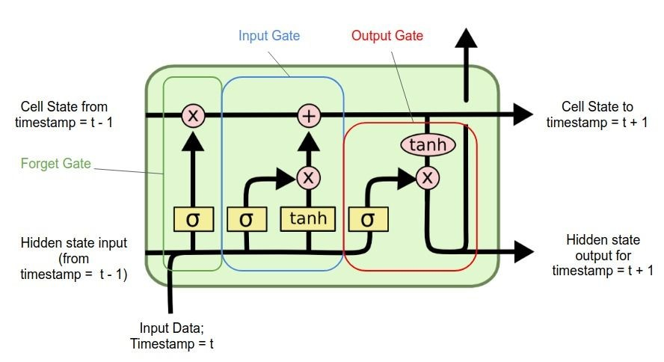
Second model LSTM

Slide 13
Second model - LSTM
LSTM(Long short term memory)-based model for sarcasm detection.
Tokenizing the text data and creating numerical sequences using the Tokenizer class from TensorFlow.
Padding the numerical sequences to ensure equal length using the pad_sequences function.
Defining the LSTM model architecture with an embedding layer, LSTM layer, and dense layer.
Compiling the model with binary cross-entropy loss and the Adam optimizer.

Slide 14
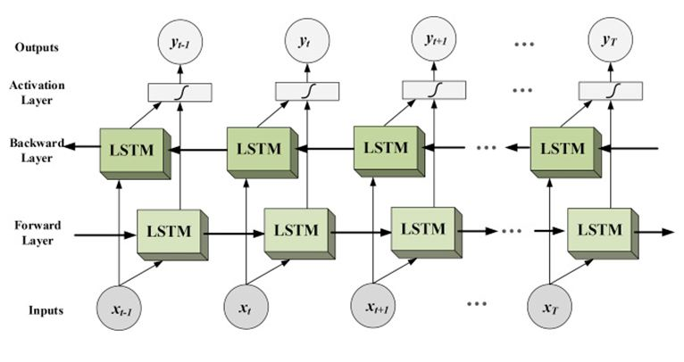
Third model : BLSTM

Slide 15
Third model - BLSTM
Bidirectional Long Short-Term Memory model for sarcasm detection.
Employing a tokenizer to convert the text into integer sequences for efficient processing.
Padding the sequences to ensure uniform input length.
Model Architecture:
Embedding Dimension: 100
Maximum Sequence Length: 100
Number of LSTM Units (First Layer): 128
Number of LSTM Units (Second Layer): 64
Number of Dense Units: 64
Dropout Rate: 0.5
Activation Function (Dense Layer): ReLU
Activation Function (Output Layer): Sigmoid
Optimizing model parameters using binary cross-entropy loss and the Adam optimizer.

Slide 16
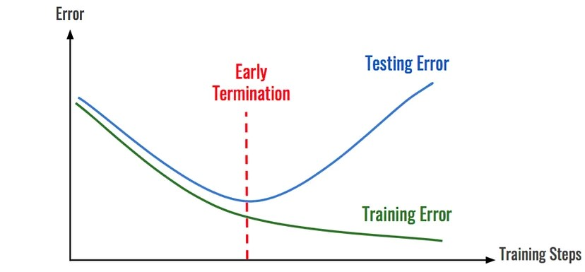
Fourth model – BLSTM using early stopping

Slide 17
Fourth model – BLSTM using early stopping
Implemented early stopping in the previous BLSTM model to prevent overfitting.
By incorporating early stopping, the model's training process was stopped if the performance on the validation set did not improve, ensuring a better balance between training and generalization.

Slide 18

Fifth model – BLSTM + BERT

Slide 19
Fifth model – BLSTM + BERT
Combining BERT and BLSTM models to leverage their strengths
Creating a unified framework that combines BERT's contextualized embeddings and BLSTM's sequential processing capabilities
BERT Model: 'bert-base-uncased'
Maximum Sequence Length: 100
Embedding Dimension: 100
Number of LSTM Units (First Layer): 128
Number of LSTM Units (Second Layer): 64

Slide 20
Fifth model – BLSTM + BERT
Activation Function (Dense Layer): ReLU
Activation Function (Output Layer): Sigmoid
Number of Dense Units: 64
Dropout Rate: 0.5

Slide 21

Results

Slide 22
Models Results
Model | Accuracy | F1-Score
SVM | 0.844 | —
LSTM | 0.55 | —
BLSTM | 0.82 | 0.78
BERT using early stop | 0.852 | —
BLSTM using early stop | 0.858 | 0.84
BLSTM + BERT | 0.73 | 0.69

Slide 23
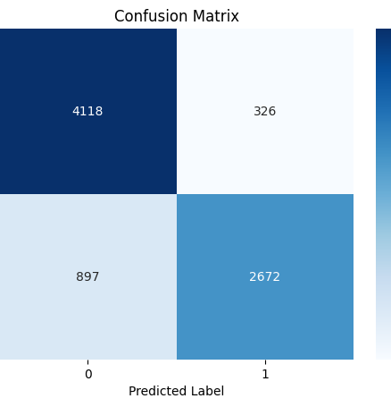
Highest result
The results of multiple models were evaluated.
The BLSTM using early stopping model achieved the highest result among all models with 0.8588543616622988 accuracy and 0.8414411888406 F1-score
The BLSTM model was tested on a different dataset version.
The performance on the new dataset version was also impressive, with an accuracy of 0.8473730188443779.
A confusion matrix was created to visualize and analyze the results.

Slide 24
Comparison with past papers
Paper title | Accuracy
Sarcasm Detection in News Headlines by Karthik Sura, Sowmith Damera, A. Marry Posonia | 0.668
Sarcasm Detection in Newspaper Headlines by P. Shrikhande, V. Setty, D. A. Sahani | 0.820
The Sarcasm Detection in News Headlines Based on Machine Learning Technology by Zanchak, Vysotska, Albota | 0.760
Our highest model | 0.858

Slide 25
Conclusion
The BLSTM model captured contextual dependencies in both forward and backward directions, leading to successful sarcasm detection.
The most effective model for sarcasm detection in news headlines was the Bidirectional Long Short-Term Memory (BLSTM) model.
The BLSTM model achieved accuracy score of 0.8588 by utilizing the early stopping technique.

Slide 26
Difficulties and overcome
Overfitting, where a machine learning model performs well on training data but fails to generalize to new data, was a significant challenge encountered during the project.
The accuracy and reliability of the models noticeably declined when evaluating them on test data or real-world scenarios, indicating clear overfitting.
To overcome overfitting, the strategy of early stopping was employed, involving monitoring the model's performance during training and stopping it before overfitting occurs.

Slide 27

Project contribution
The main objective of this project was to enhance the accuracy attained in previous studies within the field. I successfully surpassed the accuracy achieved in certain papers within the field.

Slide 28
Future work
Expand sarcasm detection to social media platforms, improving sentiment analysis and understanding user sentiment.
Develop a user-friendly application for easy access and utilization of the sarcasm detection model.

